Slide 1

[Car Rental Software]
By
[Mwanzia William Munguti]
[656333]

Slide 2
Introduction
The first car to be hired was traced back in the year 1904, when a bicycle shop in the town of Minneapolis started offering cars for rent. The first car rental company was started in Germany in the year 1912 and was called SIXT

Slide 3
Introduction
The high rise in the demands of renting of cars has brought this to be a pretty good investment opportunity. Renting of a car starts with the customer calling the car renting company and talking to the secretary.
The customer enquiries for available cars and the secretary of the company checks the records to see if the exact type is available for renting or a vehicle similar to that is available. When the vehicle is available the secretary will then declare the status of the vehicle booked. This process sometimes takes a long time since the secretary has to get the callers’ information which includes their address and the mode of payment as well.

Slide 4
Problem Statement
Rent a ride is a successful car business and is well known, therefore a mobile application will be ideal. The application will enable user to choose their location from available listed towns, since Rent a Ride has different branches all over the country.
The user should be able to log in, see the vehicles available and book it and get a confirmation message after booking the vehicle

Slide 5
objectives
General Objectives
Create a software that enables a user to select a car to rent according to the client’s location and choose the type of vehicle

Slide 6
objectives
Specific Objectives
The Application will be able to:
List all branches of Rent a ride and user will select the location they are located at.
List all cars available at a branch
Allow user to book a car
Give feedback after is booked

Slide 7
Proposed functionality
Functional Requirements
The user will be able to choose between existing user and admin.
The user will have to be authenticated when they log in.
If user is not existing, they will have to sign up entering their personal details.
The app should be able to store and retrieve data in a database.
The user should be able to select the location they are in from the listed ones.

Slide 8
Functional Requirements…
The app should be able to show the list of available cars in categories
The app should be able to give back feedback when a customer chooses their vehicle of choice
The app should be able to show the user/ customer the history of previously rented cars.
The app should generate reports on the data to the admin.

Slide 9
Non Functional Requirements
Performance- the app requires a connection to the internet for it to properly
Operating system- the app will run on an android device.
Usability- the app will be easy to use by people of all ages and will be self-explanatory

Slide 10
System Functionality
Functional
The system displays the vehicles available
The system displays their location
The system displays their features (color, registration number)
The system prompts the user before closing the software
The system prompts the user when they add a vehicle and a customer
The system allows the user to return the vehicle

Slide 11
Proposed Methodology
Agile development was used in the development pf the project.
The use of agile development enabled getting past milestones that were reached which made it possible to do something else to save time
With the iterative development of the project the development was done in bits or.
It was flexible to accommodate the changes that were taking place.
It accommodates changes in the software.
It was cost effective

Slide 12
Proposed system design

Slide 13
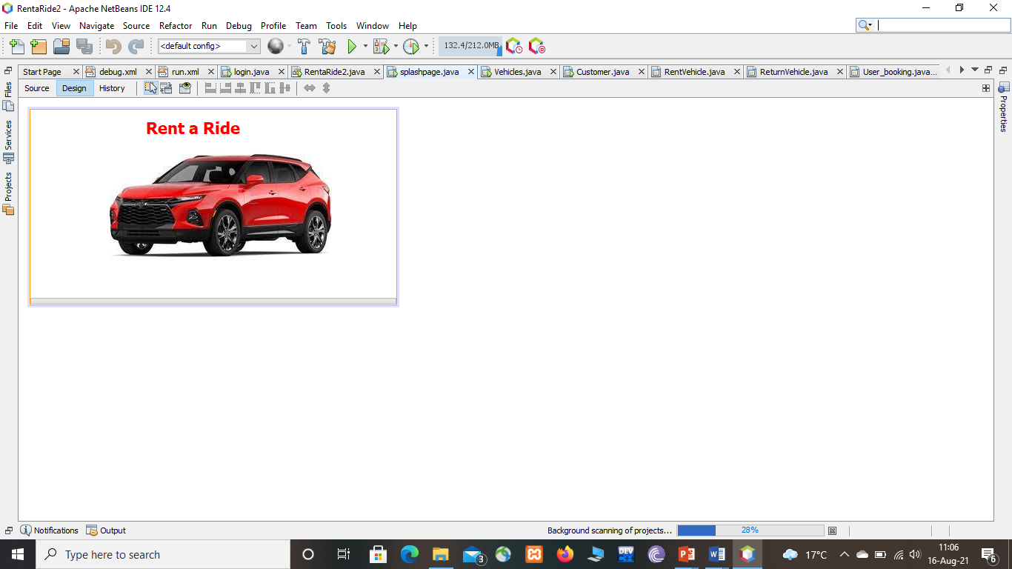
System DEsign
Splash page

Slide 14
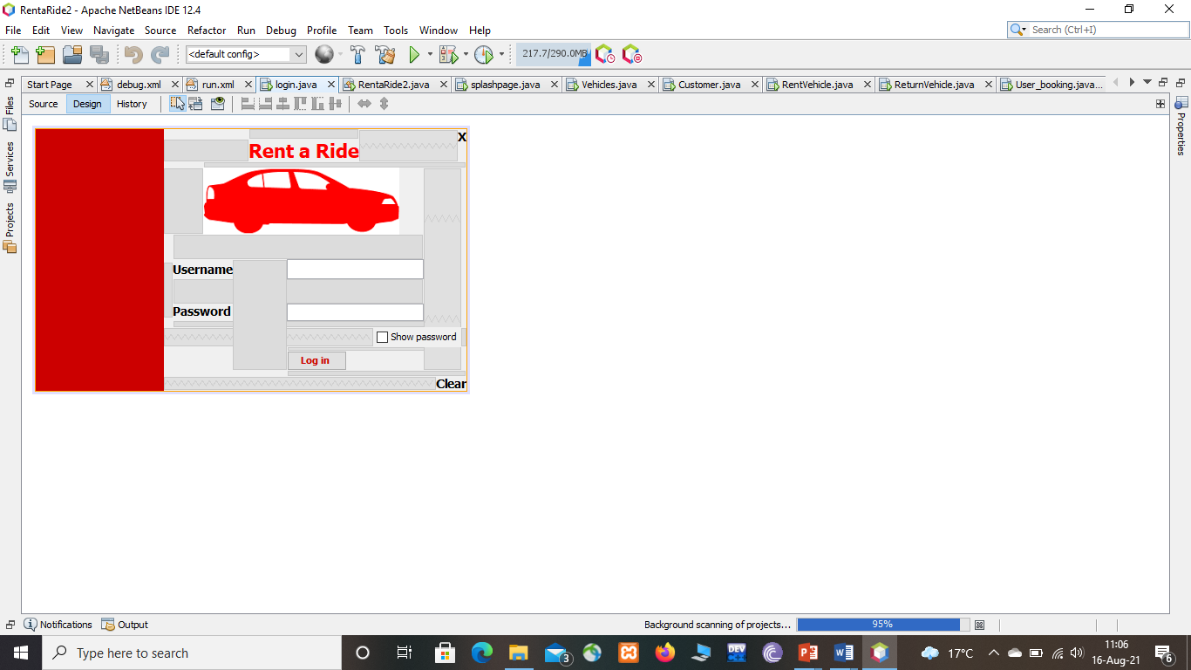
Log in

Slide 15
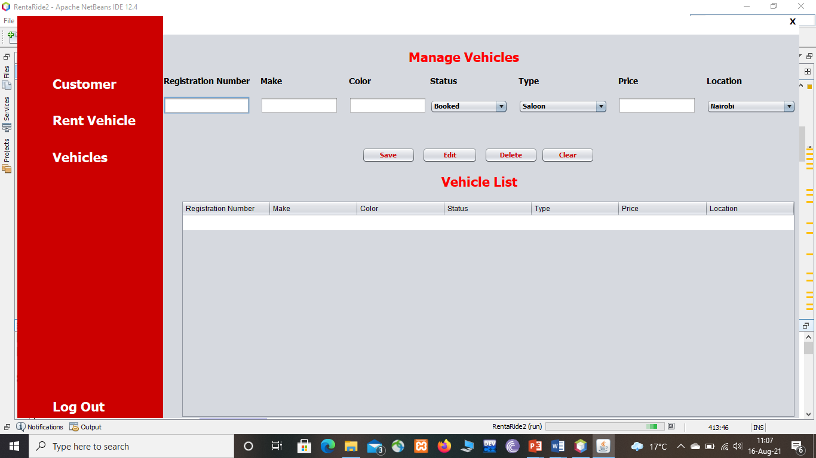
Add Vehicle

Slide 16
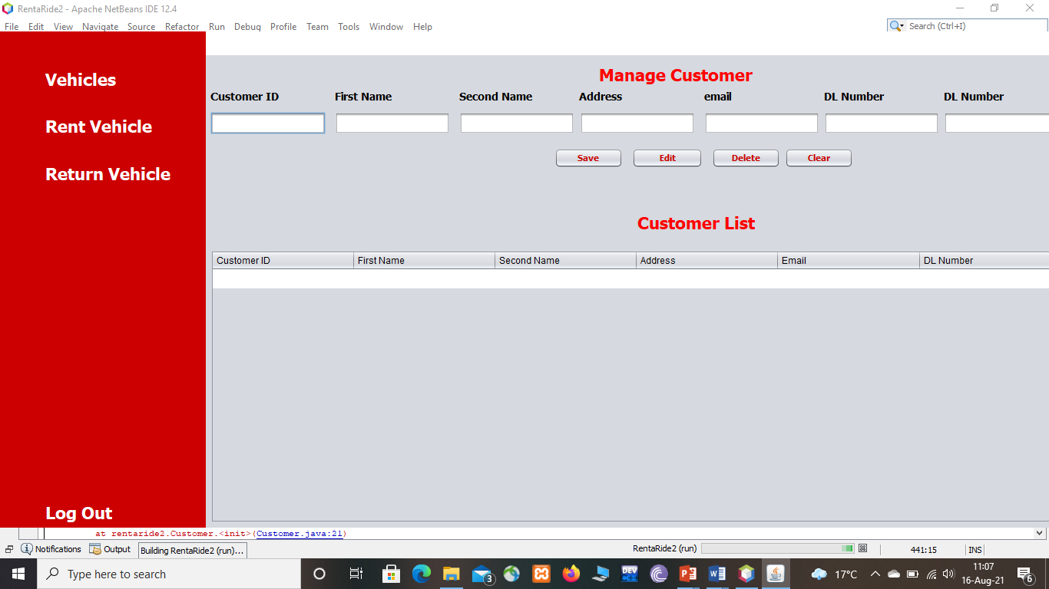
Add customer

Slide 17
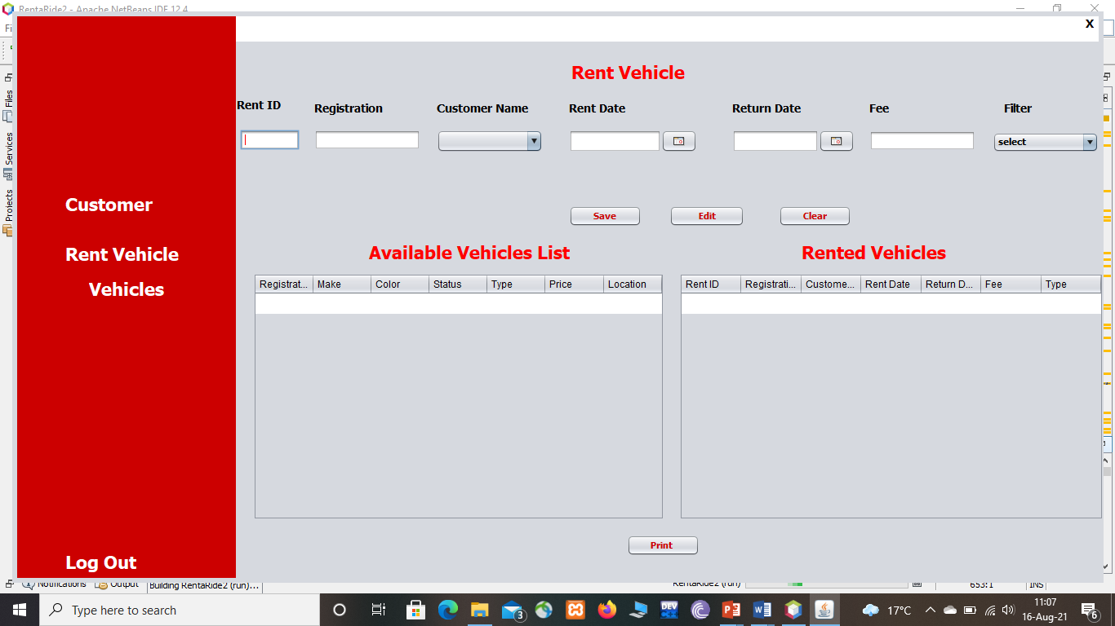
Rent vehicle

Slide 18
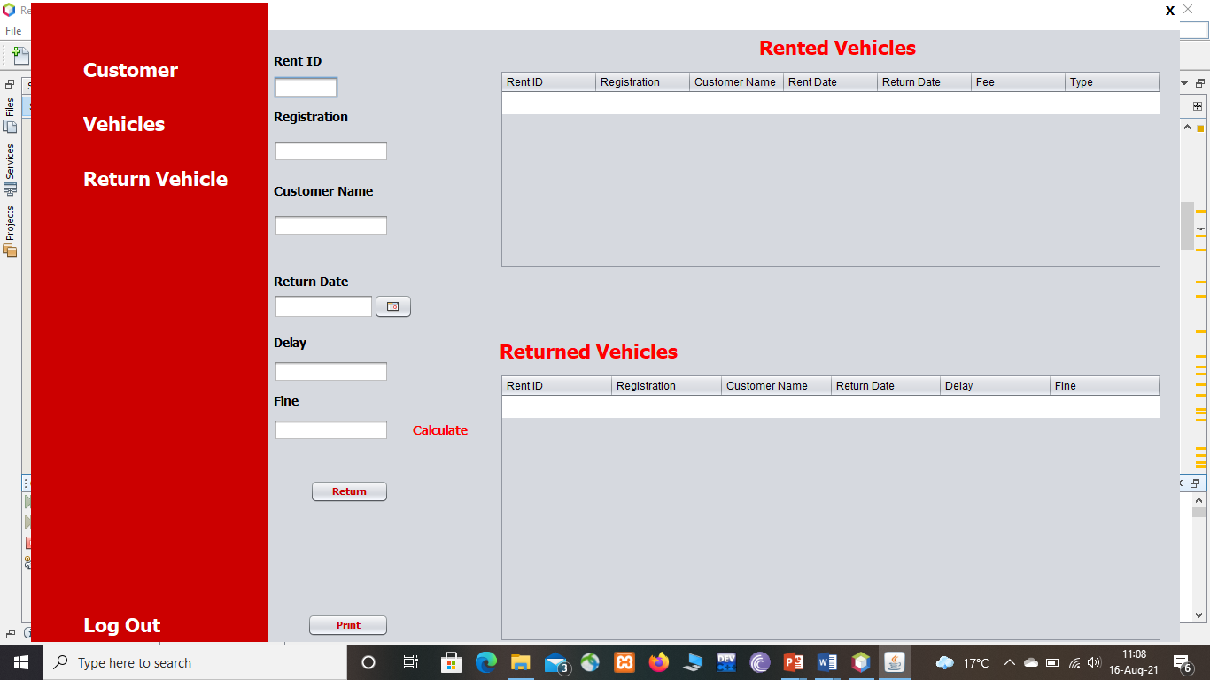
Return Vehicle

Slide 19
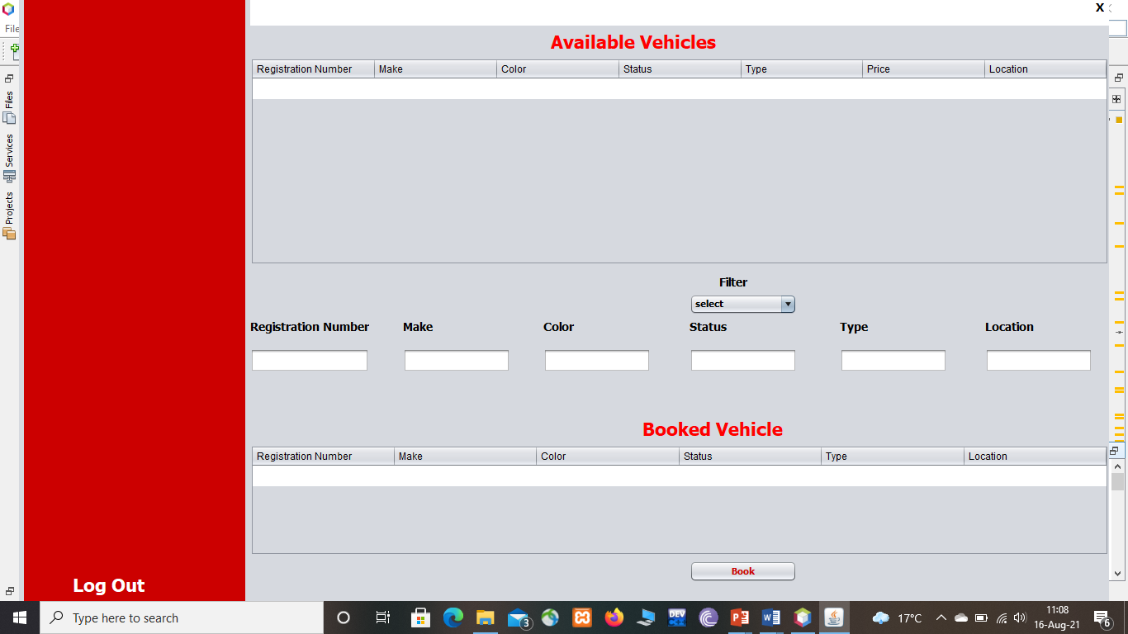
User-Booking

Slide 20
Demonstration
Live demo

